Slide 1
UNIT-III MANAGING, ORGANIZING AND ENHANCING DATA IN TABLEAU

Slide 2
Table of content
Splitting data, Pivoting & Transforming data
Blue & green pills Filters, Blue & green pills affect on dates
Cleaning data by Bulk Re-aliasing
Setting data defaults to save time later on
Create hierarchies to drill down into data
Creating groups for data
Creating and Using Sets
Create data filters
Create calculated fields,
Combine data sources using data blending
Creating & using Parameters
Bringing in More data with Joins

Slide 3
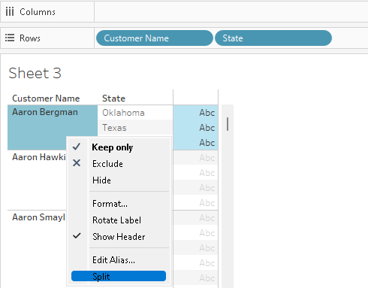
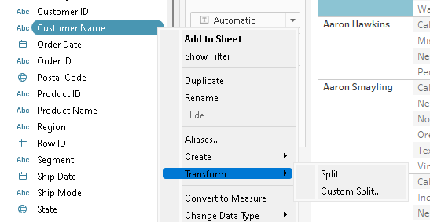
1.1 Splitting data
If you have string fields in your data that contain multiple distinct pieces of information you may be able to split the values into separate fields, based on a separator.

Slide 4
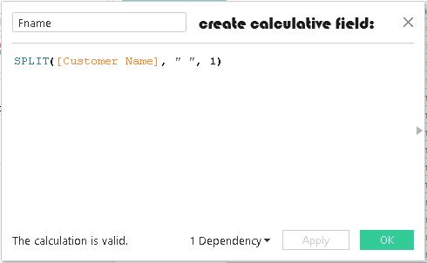
custom split
The SPLIT function works similarly to a custom split, but only one result field is returned per calculation.
You define the separator and specify which value to return by providing a token number.
First Name: SPLIT([Customer Name], " ", 1)
Last Name: SPLIT([Customer Name], " ", 2)

Slide 5
Pivoting
Sometimes, analyzing data that is stored in a crosstab format can be difficult in Tableau.
When working with Microsoft Excel, text file, Google Sheets, and .pdf data sources, you can pivot your data from crosstab format into columnar format.
Notes:
https://help.tableau.com/current/pro/desktop/en-us/pivot.htm

Slide 6
Pivot steps in tableau
Set up the data source, in the grid,
select two or more columns.
Click the drop-down arrow next to the column name,
and then select Pivot.
New columns called "Pivot field names" and "Pivot field values" are created
and added to the data source.

Slide 7
PIVOT CONTD..
Tableau often favors row-wise arrangements rather than column-wise and knowing how to pivot your data from columns to rows will enable you to optimize your analysis and make your visualizations more meaningful.
Notes:
https://blog.enterprisedna.co/how-to-pivot-data-in-tableau-3-easy-ways/#:~:text=To%20pivot%20data%20in%20Tableau%2C%20first%20load%20your%20data%20and,to%20pivot%20data%20in%20Tableau.

Slide 8
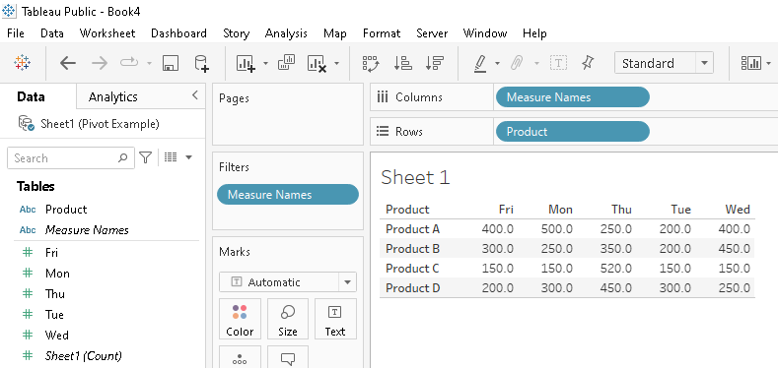
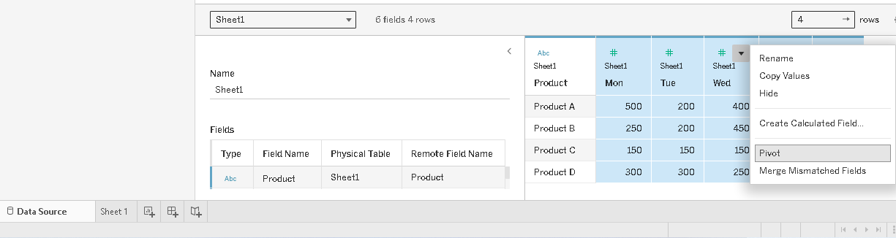

Slide 9
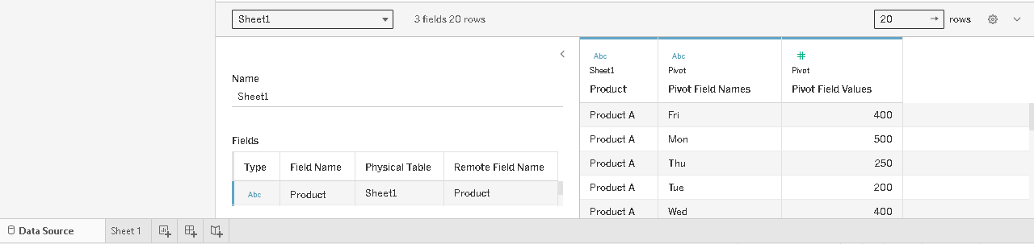
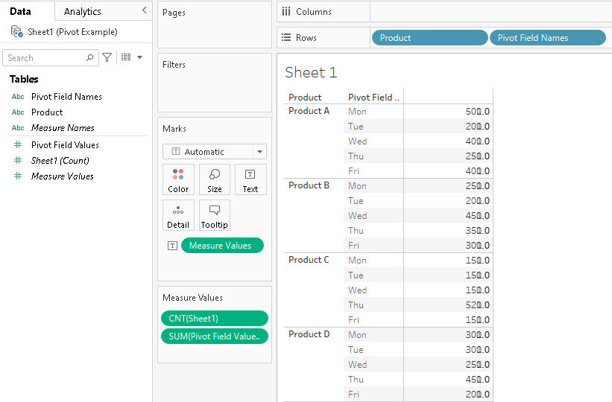

Slide 10
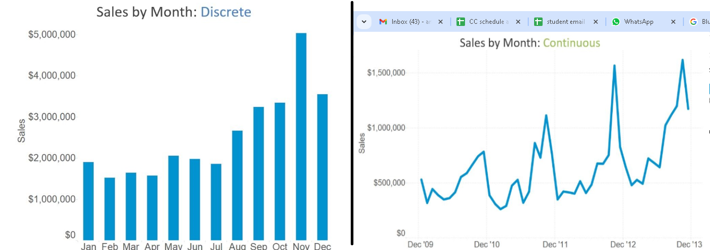
2. Blue & green pills Filters, Blue & green pills affect on dates
Blue indicates that a field is discrete, while green indicates that a field is continuous.
Discrete fields draw headers; continuous fields draw axes.
Notes:
https://evolytics.com/blog/tableau-fundamentals-discrete-vs-continuous/

Slide 11
Dimensions usually cannot be aggregated (summed, averaged etc), whereas measures can be.
Blue things group your data
Green things count your data
Dimensions split up the view
Measures fill the view
Notes:
https://discuss.boardinfinity.com/t/what-affects-do-blue-and-green-pill-have-on-dates-in-tableau/21520

Slide 12
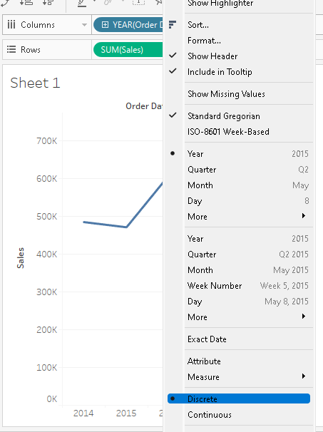
Dates can also either be discrete or continuous.
By default, when you drag a date over to either your column or row shelf, you will get a YEAR(datefield) blue pill.
Once you drag the date field onto the shelf, right click on the pill to reveal the context menu.
One of the options here is to convert the field to continuous
Notes:
https://sqlbelle.wordpress.com/2015/01/29/do-you-know-how-dates-work-in-tableau-understanding-continuous-vs-discrete-dates/

Slide 13
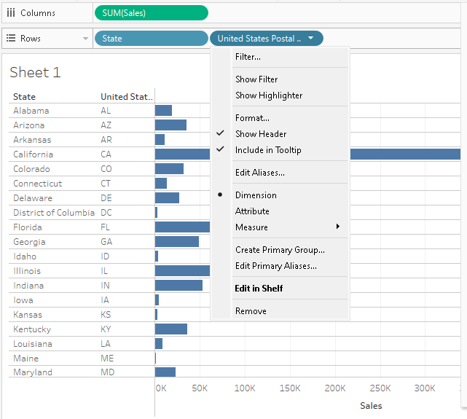
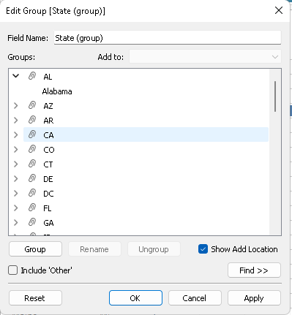
3. Cleaning data by Bulk Re-aliasing
See data blending first:
Right click then,
Create Primary Group
Click OK

Slide 14
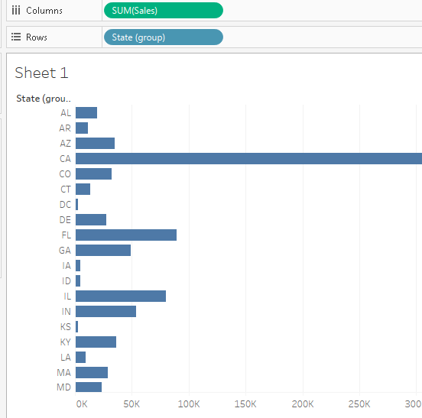
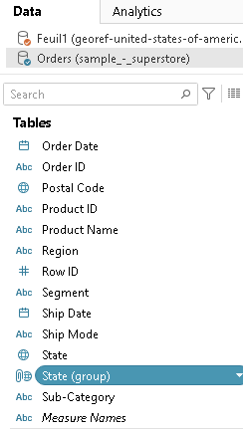

Slide 15
4. Setting data defaults to save time later on
When you drag fields to shelves, the data is represented as marks in the view.
The fields and their marks are displayed initially based on their default settings.
You can control these default settings by clicking the drop-down arrow on a field.
The Default Properties menu includes default settings for aggregation, comments, number formatting, color, shape, and totals (based on the type of field).

Slide 16
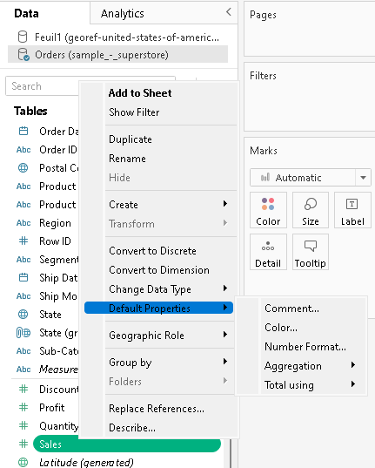

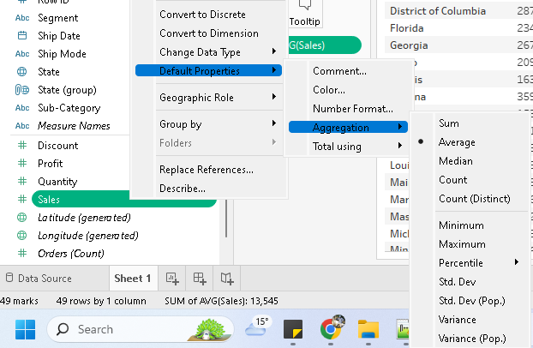
https://help.tableau.com/current/pro/desktop/en-us/datafields_fieldproperties.htm

Slide 17

5. Create hierarchies to drill down into data
When you connect to a data source, Tableau automatically separates date fields into hierarchies so you can easily break down the viz.
We can also create your own custom hierarchies.
For example, if you have a set of fields named Region, State, and County, you can create a hierarchy from these fields so that you can quickly drill down between levels in the viz.

Slide 18
In the Data pane, drag a field and drop it directly on top of another field.
When prompted, enter a name for the hierarchy and click OK.
Drag additional fields into the hierarchy as needed. You can also re-order fields in the hierarchy by dragging them to a new position.
In the Data pane, right-click (control-click on a Mac) the hierarchy and select Remove Hierarchy.
https://help.tableau.com/current/pro/desktop/en-us/qs_hierarchies.htm

Slide 19
6. Creating groups for data
You can create a group to combine related members in a field.
For example, if you are working with a view that shows average test scores by major, you might want to group certain majors together to create major categories.
English and History might be combined into a group called Liberal Arts Majors, while Biology and Physics might be grouped as Science Majors.
Groups are useful for both correcting data errors (e.g., combining CA, Calif., and California into one data point) as well as answering "what if" type questions (e.g., "What if we combined the East and West regions?).

Slide 20
Groups contd…
In the Data pane, right-click a field and select Create > Group.
In the Create Group dialog box, select several members that you want to group, and then click Group.
To rename the group, select it in the list and click Rename.

Slide 21
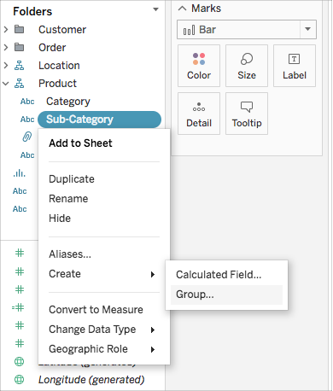
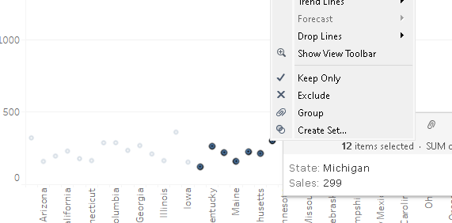

Slide 22
7. Creating and Using Sets
sets are dynamic while groups are not. When your data changes the set will update with it while this is not an option with groups.
In the Data pane, right-click a dimension and select Create > Set.
In the Create Set dialog box, configure your set.
After you create a set, it displays at the bottom of the Data pane in the Sets section. You can drag it into the viz like any other field.

Slide 23
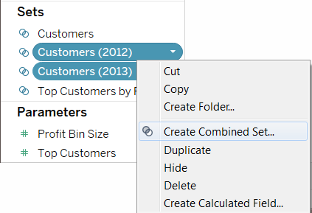
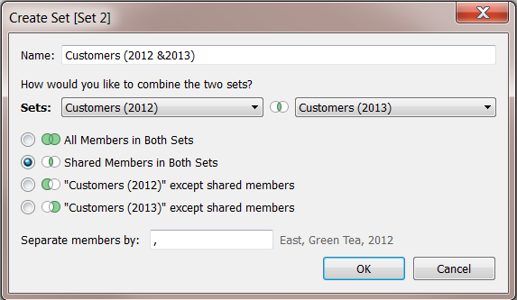
How do members of a set contribute to the total?
Crete a simple set
How many members of a set exist in another set?
Combining the sets

Slide 24
8. Create data filters
Tableau performs actions on your view in a very specific order; this is called the Order of Operations. Filters are executed in the following order:
Extract filters
Data source filters
Context filters
Filters on dimensions (whether on the Filters shelf or in filter cards in the view)
Filters on measures (whether on the Filters shelf or in filter cards in the view)
https://help.tableau.com/current/pro/desktop/en-us/filtering.htm

Slide 25
Select to keep or exclude data points in your view
Drag dimensions, measures, and date fields to the Filters shelf
Filter categorical data (dimensions)
Filter quantitative data (measures)
show a filter in the view

Slide 26
9. Create calculated fields
https://help.tableau.com/current/pro/desktop/en-us/calculations_calculatedfields_formulas.htm

Slide 27
10. Combine data sources using data blending
Data blending is a method for combining data from multiple sources.
Data blending brings in additional information from a secondary data source and displays it with data from the primary data source directly in the view.

Slide 28
Relationships are the default method and can be used in most instances, including across tables with different levels of detail.
Relationships are flexible and adapt to the structure of the analysis on a sheet by sheet basis. However, you can't create relationships between tables from published data sources.
Joins combine tables by adding more columns of data across similar row structures.
This can cause data loss or duplication if tables are at different levels of detail, and joins must be established before analysis can begin.
You can't use a published data source in a join.

Slide 29
Blends, unlike relationships or joins, never combine the data directly.
Instead, blends query each data source independently, aggregate the results to the appropriate level, then present the results together visually in the view.
Because of this, blends can handle different levels of detail and also work with published data sources.
Blends don't create a new, blended data source (and therefore can't be published as a "blended data source").
Instead, they are simply blended results visualized per sheet.

Slide 30
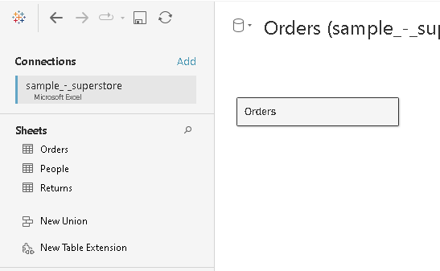
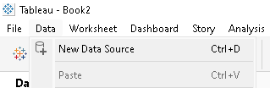
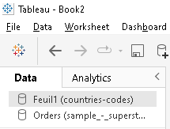
The second data source should be added by going to Data > New data source.
Drag a field to the view. This data source will be the primary data source.

Slide 31
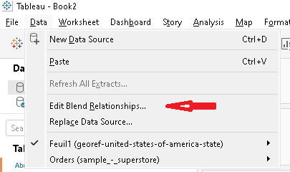
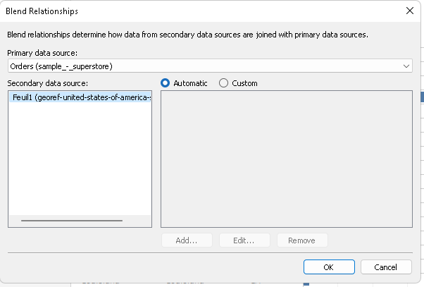
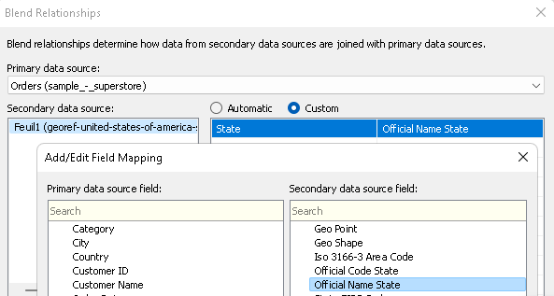
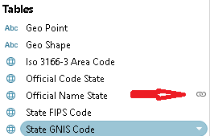

Slide 32
If there is a linking field icon , the data sources are automatically linked. As long as there is at least one active link, the data can be blended.
If there are broken link icons , click the icon next to the field that should link the two data sources. The slash will go away, representing an active link.

Slide 33
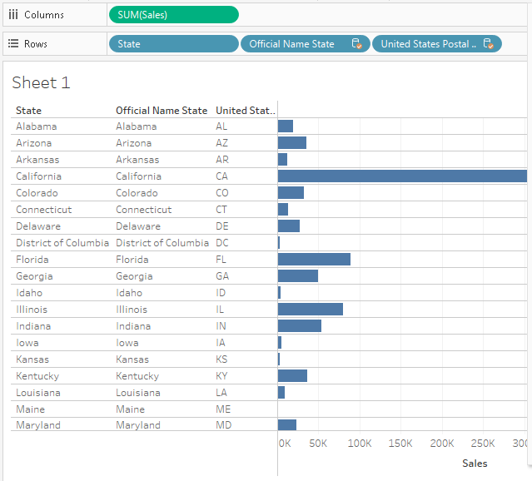

Slide 34
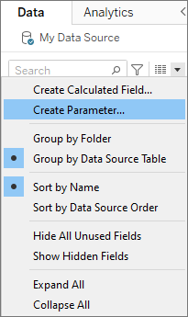
11. Creating & using Parameters
In the Data pane, click the drop-down arrow in the upper right corner and select Create Parameter.
In the Create Parameter dialog box, give the field a Name.
Specify the data type for the values it accepts.

Slide 35
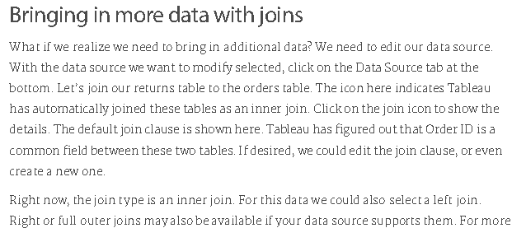
12. Bringing in More data with Joins
https://www.scribd.com/document/581537257/getting-started-with-data-transcript

Slide 36
